Slide 1

Real Estate & Property Management Dashboard
Domain : Real Estate sales & Brokerage
Designed & Presented By
Jnanaranjan Pradhan (Data Analyst)

Slide 2

About Business Model:
Real estate and property management are closely related fields that involve the acquisition, ownership, operation, and oversight of real property (land and buildings).
Here's an overview of both areas:
Real Estate:
Definition: Real estate refers to physical land and any permanent improvements attached to it, such as buildings, houses, and infrastructure. It can be categorized into various types, including residential, commercial, industrial, and agricultural.
Investment: Many people invest in real estate to generate income and build wealth. Real estate investments can include buying, renting, or selling properties. Common strategies include residential rental properties, commercial real estate, and real estate investment trusts (REITs).
Property Types: Real estate encompasses a wide range of property types, including single-family homes, apartment complexes, office buildings, shopping centers, warehouses, and more.
Financing: Real estate transactions often involve significant financing through mortgages or loans. The real estate market can be influenced by interest rates, economic conditions, and local factors.
Property Valuation: Determining the value of a property is crucial for buying, selling, or financing real estate. Methods include comparative market analysis (CMA), appraisals, and income capitalization approaches.

Slide 3
Property Management:
Definition: Property management involves the day-to-day operation and oversight of real estate properties on behalf of the owner or investor. It aims to maximize property value and rental income while ensuring tenant satisfaction and property maintenance.
Responsibilities: Property managers handle tasks such as tenant screening, lease agreements, rent collection, property maintenance, repairs, and handling tenant issues and complaints. They also manage budgets and finances related to the property.
Legal Compliance: Property managers must stay updated on local, state, and federal laws and regulations related to property rental, tenant rights, fair housing, and property maintenance standards.
Property Maintenance: Regular maintenance and upkeep of the property are essential to preserve its value and attract and retain tenants. Property managers often coordinate maintenance and repairs with contractors and service providers.
Tenant Relations: Building positive relationships with tenants is crucial for property managers. Effective communication, addressing tenant concerns promptly, and providing a safe and comfortable living environment are key aspects of tenant relations.
Financial Management: Property managers typically handle rent collection, budgeting, and financial reporting for property owners. They ensure that the property operates within budget and generates a positive cash flow.
Marketing and Tenant Acquisition: Property managers may also be responsible for marketing vacant units, conducting showings, and screening prospective tenants to fill vacancies.

Slide 4
Tools Used:
Power BI Desktop
SQL
Excel
Dax Studio(For Report Optimization)
CHATGPT & Google
PowerPoint
"Adobe.color.com " for choosing color
"flaticon.com" for choosing the icon.

Slide 5
First, we load the dataset into Power BI using the 'Get Data' option. After that, we transform the data in Power Query. In Power Query, we remove unwanted columns from the dataset using the 'Remove Column' option and add new columns using the 'Column from Example' feature in the 'Add Column' option.
We removed the 'Zipcode,' 'lat,' 'long,' 'Sqft_living15,' 'Sqft_lot15,' 'grade,' 'sqft_above,' 'sqft_basement,' 'view,' 'sqft_living,' 'sqft_lot,' and 'id' columns from the dataset because they were unwanted.
Then we add new column
1.We added a new column named 'Bedrooms' using the 'Bedroom' column as an example in the 'Add Column' option. Afterward, we removed the 'Bedroom' column.
2.We added a new column named 'Floors' using the 'Floor' column as an example in the 'Add Column' option. Afterward, we removed the 'Floor' column.
3.We added a new column named 'Waterfront status' using the 'Waterfront' column as a condition in the 'Add Column' option. The condition was set as follows: if 'Waterfront' is equal to 1, then the value is 'Yes'; otherwise, it is 'No’.
4.We added a new column named 'Condition Status' using the 'Condition' column as a condition in the 'Add Column' option. The condition was defined as follows: if 'Condition' is equal to 1, then the value is 'Very good'; if 'Condition' is equal to 2, the value is 'Good'; otherwise, it is 'Bad.' After that, we removed the 'Condition' column from the dataset.
5.We added a new column called 'Interval' using the 'Yr_built' and 'Yr_renovated' columns with the help of the 'Custom Column' option in the 'Add Column' menu. In this custom column, we calculated the interval by subtracting 'Yr_built' from 'Yr_renovated'.

Slide 6
6.We added a new column named 'Renovation Status' using the 'Interval' column with the help of the 'Add Conditional Column' option in the 'Add Column' menu. The condition we specified was as follows: if the 'Interval' is greater than 0, then the value is 'Renovated'; otherwise, it is 'Not renovated.
We used the 'Detect Data Type' option to check the data type of each column. Afterward, we changed the table name from 'Kc_house_data' to 'FactTable.
We duplicated the 'FactTable' table using the 'Duplicate' option and named it 'Dim_location.' In the 'Dim_location' table, we removed all other columns except the 'Property location' column. Using the 'Remove Duplicate' option, we eliminated duplicate values in the 'Property location' column. Finally, we added a new column named 'Location ID' to the 'Dim_location' table with the help of the 'Index Column' feature in the 'Add Column' menu.
We duplicated the 'FactTable' table using the 'Duplicate' option and named it 'Dim_Bedrooms.' In the 'Dim_Bedrooms' table, we removed all other columns except the 'Property Bedrooms' column. Using the 'Remove Duplicate' option, we eliminated duplicate values in the 'Property Bedrooms' column. Finally, we added a new column named 'Bedrooms ID' to the 'Dim_Bedrooms' table with the help of the 'Index Column' feature in the 'Add Column' menu.
We duplicated the 'FactTable' table using the 'Duplicate' option and named it 'Dim_Floors.' In the 'Dim_Floors' table, we removed all other columns except the 'Floors' column. Using the 'Remove Duplicate' option, we eliminated duplicate values in the 'Floors' column. Finally, we added a new column named 'Floors ID' to the 'Dim_Floors' table with the help of the 'Index Column' feature in the 'Add Column' menu.

Slide 7
We duplicated the 'FactTable' table using the 'Duplicate' option and named it 'Dim_waterfront.' In the 'Dim_waterfront' table, we removed all other columns except the 'Waterfront status' column. Using the 'Remove Duplicate' option, we eliminated duplicate values in the 'Waterfront status' column. Finally, we added a new column named 'Waterfront ID' to the 'Dim_waterfront' table with the help of the 'Index Column' feature in the 'Add Column' menu.
We duplicated the 'FactTable' table using the 'Duplicate' option and named it 'Dim_Conditional_Status.' In the 'Dim_Conditional_Status' table, we removed all other columns except the 'Conditional_Status' column. Using the 'Remove Duplicate' option, we eliminated duplicate values in the 'Conditional_Status' column. Finally, we added a new column named 'Conditional_Status ID' to the 'Dim_Conditional_Status' table with the help of the 'Index Column' feature in the 'Add Column' menu.
We duplicated the 'FactTable' table using the 'Duplicate' option and named it 'Dim_Renovation_Status.' In the 'Dim_Renovation_Status' table, we removed all other columns except the 'Renovation_Status' column. Using the 'Remove Duplicate' option, we eliminated duplicate values in the 'Renovation_Status' column. Finally, we added a new column named 'Renovation_Status ID' to the 'Dim_Renovation_Status' table with the help of the 'Index Column' feature in the 'Add Column' menu.
We used the 'Merge Queries' option to join the 'FactTable' table with 'Dim_location,' 'Dim_Bedrooms,' 'Dim_Floors,' 'Dim_WaterFront,' 'Dim_Conditional_Status,' and 'Dim_Renovation_Status'.
We removed the 'Property location,' 'Bedrooms,' 'Floors,' 'Waterfront_status,' 'Conditional_Status,' and 'Renovation_Status' columns from the 'FactTable.

Slide 8
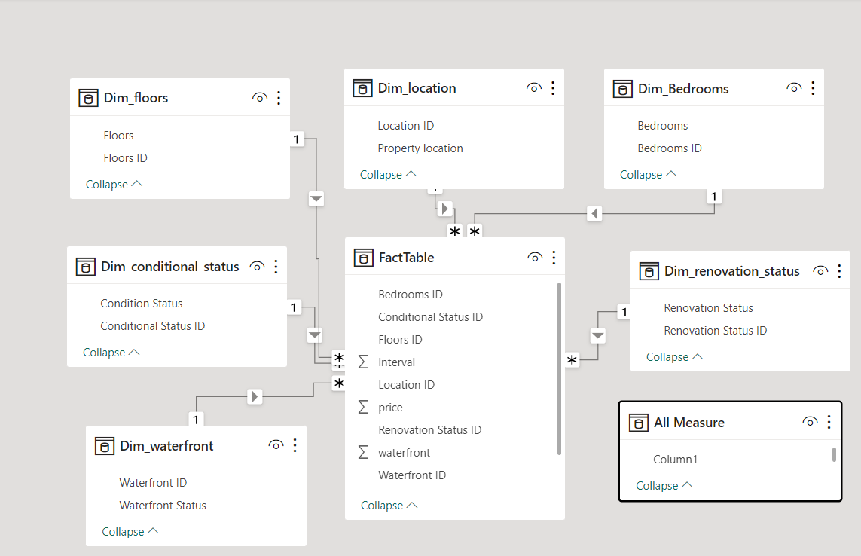
Model View:

Slide 9
KPI:
1.Total Bedrooms:
Total Properties = COUNTROWS(FactTable)
2.Total Waterfront yes:
Waterfront yes = CALCULATE([Total Properties],FactTable[Waterfront ID]=1)
3.Total Waterfront No:
Waterfront No = CALCULATE([Total Properties],Dim_waterfront[Waterfront Status]="No")
4.Total % Waterfront yes :
% Waterfront Yes = DIVIDE([Waterfront yes],[Total Properties],0)
5.Total % Waterfront No :
% Waterfront No = DIVIDE([Waterfront No],[Total Properties],0)
6.Total Renovated:
Renovated = CALCULATE([Total Properties],Dim_renovation_status[Renovation Status]="Renovated")
7.Total NotRenovated:
Renovated = CALCULATE([Total Properties],Dim_renovation_status[Renovation Status]="Notrenovated")
8.% Renovated = DIVIDE([Renovated],[Total Properties],0)
9.% Notrenovated = DIVIDE([Not Renovated],[Total Properties],0)

Slide 10
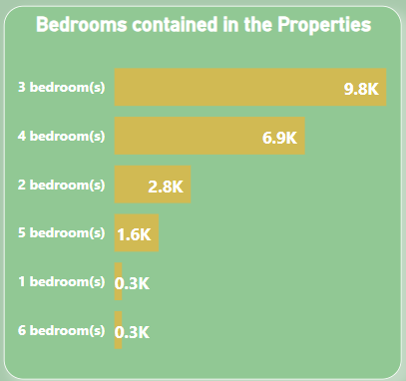
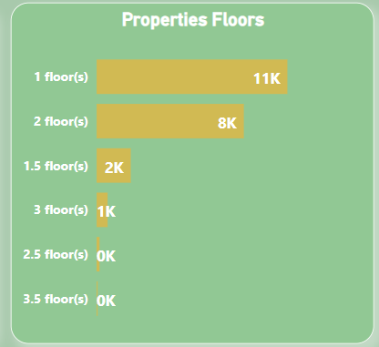
In a stacked bar chart, it is evident that the total number of properties varies according to the number of bedrooms. There is a higher number of properties available with 3 bedrooms and 4 bedrooms. Conversely, there are fewer properties available with 1 bedroom and 6 bedrooms. The higher availability of 3-bedroom and 4-bedroom properties suggests that these configurations are more popular among buyers. This design choice by the dealer aligns with the higher demand for such properties
In a stacked bar chart, we observe the total number of properties categorized by the number of floors. There is a higher number of properties available with 1 floor and 2 floors. Conversely, there are fewer properties available with 2.5 floors and 3.5 floors. The higher availability of properties with 1 floor and 2 floors suggests that these configurations are more popular among buyers. This design choice by the dealer aligns with the greater demand for properties with these specifications.

Slide 11
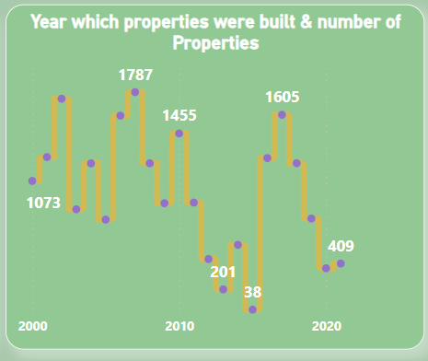
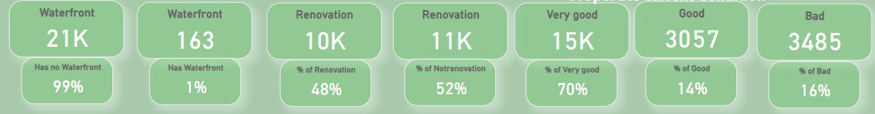
In a line chart, we can observe the number of buildings constructed in each year. It is evident that there was a higher number of buildings built in 2002 and 2007, while fewer buildings were constructed in 2015.

Slide 12
Key insights in the fields of real estate and property management include:
Location Is Crucial: In real estate, location is often the most significant factor influencing property value and demand. Factors such as proximity to amenities, schools, transportation, and job centers can greatly impact the desirability and price of a property.
Diversification in Real Estate Investments: Diversifying your real estate investments across different property types (residential, commercial, industrial) and geographic locations can help mitigate risks and enhance long-term returns.
Market Cycles: Real estate markets go through cycles of boom and bust. Understanding market cycles and timing your investments can be key to success. Buying during a downturn and selling during an upswing can lead to profitable transactions.
Risk Management: Real estate investments come with various risks, including market risk, credit risk (if financing), and property-specific risks. Effective risk management strategies include thorough due diligence, property inspections, and financial analysis.
Financing Options: Understanding different financing options, such as mortgages, loans, and partnerships, is crucial for real estate investors. The choice of financing can impact cash flow, return on investment, and overall risk.
Tenant Selection and Management: In property management, choosing the right tenants through rigorous screening processes can significantly reduce the likelihood of problems and late rent payments. Effective tenant management and communication are key to tenant satisfaction and retention.

Slide 13
7.Legal Knowledge: Property managers must have a strong understanding of local and national real estate laws, including tenant-landlord regulations, fair housing laws, and property maintenance standards. Compliance is essential to avoid legal issues.
8.Maintenance and Asset Preservation: Regular property maintenance not only ensures tenant satisfaction but also preserves the long-term value of the property. Neglecting maintenance can lead to costly repairs and decreased property value.
9.Financial Management: Property managers should have solid financial management skills to handle rent collection, budgeting, and financial reporting. Accurate financial records are essential for property owners and investors.
10.Technology and Innovation: The real estate industry is increasingly adopting technology and innovation. Property managers can benefit from using property management software, online marketing platforms, and smart building technologies to streamline operations and enhance tenant experiences.
11.Environmental Sustainability: Sustainability is becoming a more significant factor in property management and real estate investment. Energy-efficient buildings and sustainable practices can reduce operating costs and attract environmentally conscious tenants.
12.Property Appreciation: Real estate investments can appreciate over time, providing a source of wealth and potential for capital gains. Understanding factors that drive property appreciation, such as neighborhood development and economic growth, is important.
13.Exit Strategies: Successful real estate investors and property managers consider exit strategies from the outset. Whether it's selling a property, refinancing, or passing it down to heirs, having a clear plan can optimize returns.
14.Networking: Building a network of real estate professionals, including realtors, contractors, property managers, and financiers, can provide valuable insights, opportunities, and support in the industry.

Slide 14

Thanks you
If you want to view my live dashboard, please click on the 'Live Dashboard' link below:
Live Dashboard

